Slide 1


Analysis and Design of Algorithms
Transform Coding
Chapter 3: Brute Force
School of Software Engineering © Ye Luo

Slide 2
Brute Force
Brute Force
A straightforward approach, usually based directly on the problem’s statement and definitions of the concepts involved
  Example:
    Computing a^{n} (a > 0, n and a are nonnegative integer)
    Computing n!
    Multiplying two matrices
    Searching for a key of a given value in a list
    Consecutive Integer Algorithm for gcd (m,n)

Slide 3
Brute-Force Sorting Alg. — Selection Sort
Idea of Selection Sort
  Problem
  Given an array of n orderable items (e.g. numbers, characters from some alphabet, character strings), rearrange them in non-decreasing order

Slide 4
Selection Sort
  Idea
  Scan the entire array to find its smallest element and swap it with the first element. － put the smallest element in its final position in the sorted array
  Starting with the second element, to find the smallest among the next n-1 elements and swap it with the second element. － put the second smallest element in its final position in the sorted array
  Generally, on pass i (0 ≤ i ≤ n-2), find the smallest element in A[i..n-1] and swap it with A[i]:
  After n-1 passes, the array is sorted
A[0] ≤ . . . ≤ A[i-1] | A[i], . . . , A[min], . . ., A[n-1]
in their final positions

Slide 5
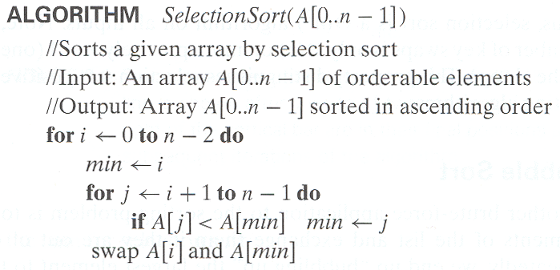
Selection Sort

Slide 6
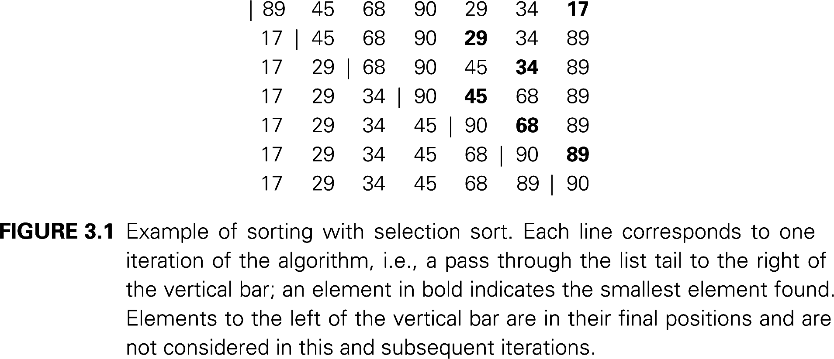
Selection Sort
  Example:
    Selection Sort on the list {89, 45, 68, 90, 29, 34, 17 }

Slide 7
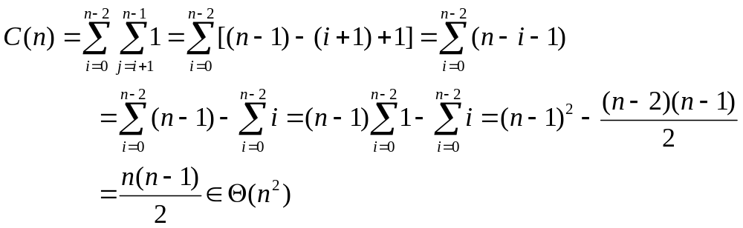
Selection Sort
Analysis of Selection Sort
Basic operation: key comparison A[j] < A[min]
Input size: number of elements, n
Time efficiency Θ (n ²)
Number of key swaps: Θ (n)

Slide 8
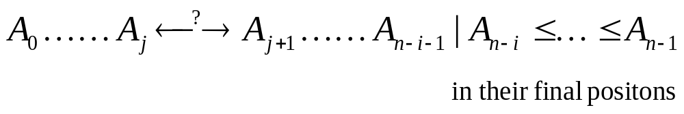
Brute-Force Sorting Alg. — Bubble Sort
Idea of Bubble Sort
  Idea
  Compare adjacent elements of the list and exchange them if they are out of order
  By doing it repeatedly, we end up “bubbling” the largest element to the last position on the list
  The next past bubbles up the second largest element, and so on until, after n-1 passes, the list is sorted
  Pass i

Slide 9
Bubble Sort
ALGORITHM BubbleSort (A [0…n-1])
{
// Sorts a given array by bubble sort;
// Input: An array A[0…n-1] of orderable elements
// Output: Array A[0…n-1] sorted in ascending order
For i ← 0 to n-2 do
For j ← 0 to n-2-i do
if A[j+1] < A[j] swap A[j] and A[j+1]
}

Slide 10
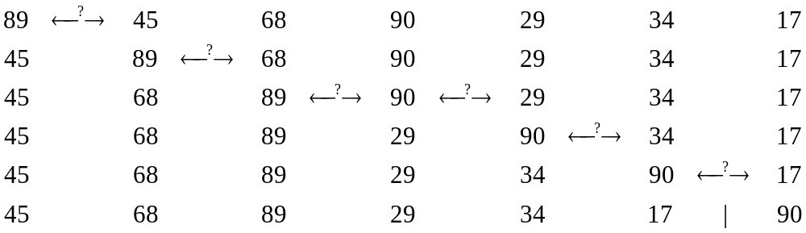
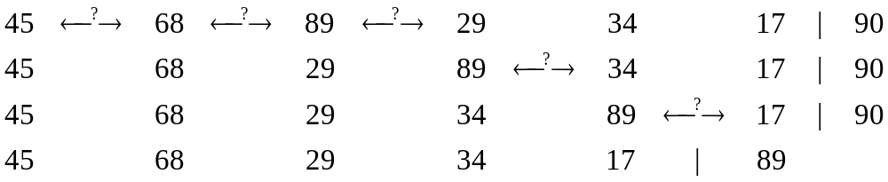
Bubble Sort
  Example:
    Bubble Sort on the list {89, 45, 68, 90, 29, 34, 17 }

Slide 11
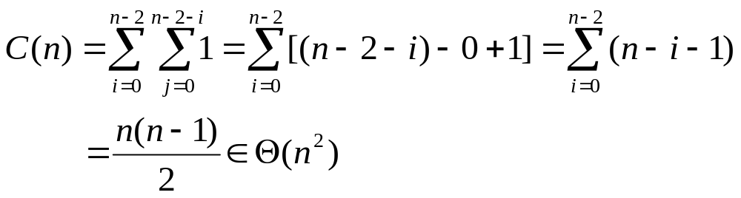
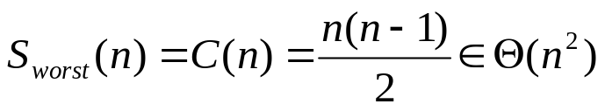
Bubble Sort
Analysis of Bubble Sort
Basic operation: key comparison
Input size: number of elements, n
Time efficiency Θ (n ²)
number of key swaps: depends on the input
Thinking: if a pass through the list makes no exchanges, the list has been sorted and we can stop the algorithm

Slide 12
Exhaustive Search
Problem
Searching for an element with a special property, in a domain that grows exponentially (or faster) with an instance size,
Usually involve combinatorial objects such as permutations, combinations, or subsets of a set.
Many such problems are optimization problems, to find an element that maximizes or minimizes some desired characteristic
such as a path’s length or an assignment’s cost
Notes:
在一个复杂度随实例规模指数增长的域中，查找一个具有特定属性的元素，
组合对象

Slide 13
Exhaustive Search
Exhaustive Search— Brute-Force for combinatorial
  Generate a list of all potential solutions to the problem in a systematic manner
  Selecting those of them that satisfy all the constraints
  Evaluate potential solutions one by one, disqualifying infeasible ones and, for an optimization problem, keeping track of the best one found so far
  Then search ends, announce the desired solution(s) found (e.g. the one that optimizes some objective function )
  typically requires for generating certain combinatorial objects
Notes:
生成问题的所有可能的解，或问题域中的每一个元素
选出其中满足问题约束的元素
然后找到一个期望元素（如，使目标函数达到最优的元素）
虽然思想简单直接，但是在实现时，常会要求算法生成组合对象

Slide 14
Exhaustive Search: Traveling Salesman Problem
Idea
  Problem
  Given n cities with known distances between each pair, find the shortest tour that passes through all the cities exactly once before returning to the starting city
  Idea
  weighted graph:
  vertices: cities
  edge weights: distances
  Alternatively: To find shortest Hamiltonian circuit in a weighted connected graph
  Hamiltonian circuit: a cycle that passes through all the vertices of the graph exactly once
Notes:
迄今为止，这类问题中没有一个找到有效算法。倾向于接受NP完全问题（NP-Complet或NPC）和NP难题（NP-Hard或NPH）不存在有效算法这一猜想，认为这类问题的大型实例不能用精确算法求解，必须寻求这类问题的有效的近似算法。
此类问题中，经典的还有 子集合 问题； Hamilton回路问题；最大团问题等

Slide 15
Exhaustive Search: Traveling Salesman Problem
  Idea
  Hamiltonian circuit can be defined as a sequence of n+1 adjacent vertices v_{i0}, v_{i1}, v_{i2},….., v_{in-1}, v_{i0}
  Generating all the permutations of n-1 intermediate cities
  Computing the tour lengths
  Find the shortest among them

Slide 16
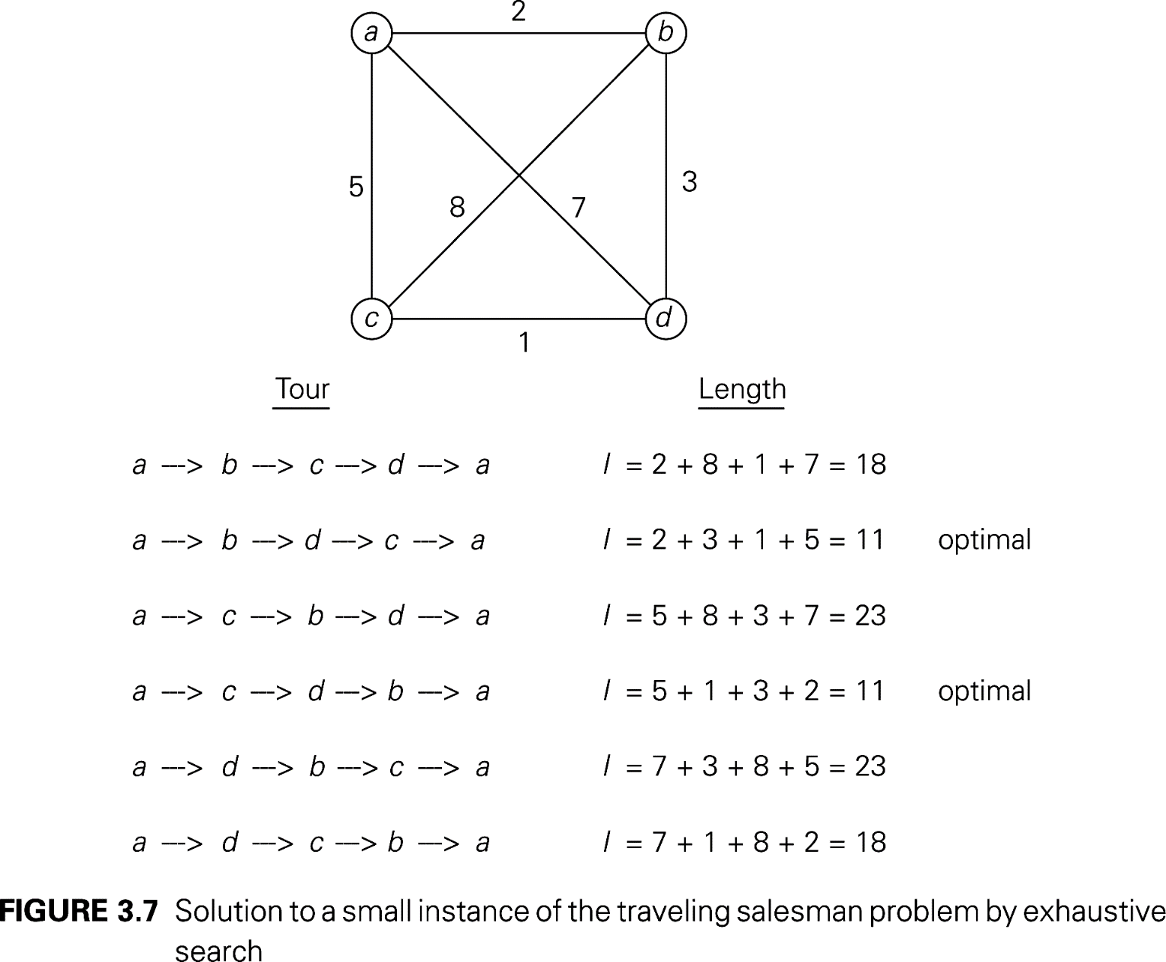
Traveling Salesman Problem
  Example:

Slide 17
Traveling Salesman Problem
Analysis of Exhaustive Search for TSP
number of permutations (n-1)!

Slide 18
Exhaustive Search: Knapsack Problem
Idea
  Problem
  Given
  weights: w₁ w₂ … w_{n}
  values: v₁ v₂ … v_{n}
  a knapsack of capacity W
  find the most valuable subset of the items that fit into the knapsack

Slide 19
Exhaustive Search: Knapsack Problem
  Idea
  generating all subsets of the set of n items given
  computing the total weight of each feasible subset (i.e. the ones with the total weight not exceeding the knapsack’s capacity)
  finding a subset of the largest value among them
Notes:
相似问题经常出现在商业、组合数学，计算复杂性理论、密码学和应用数学等领域中。
它是在1978年由Merkel和Hellman提出的。

Slide 20
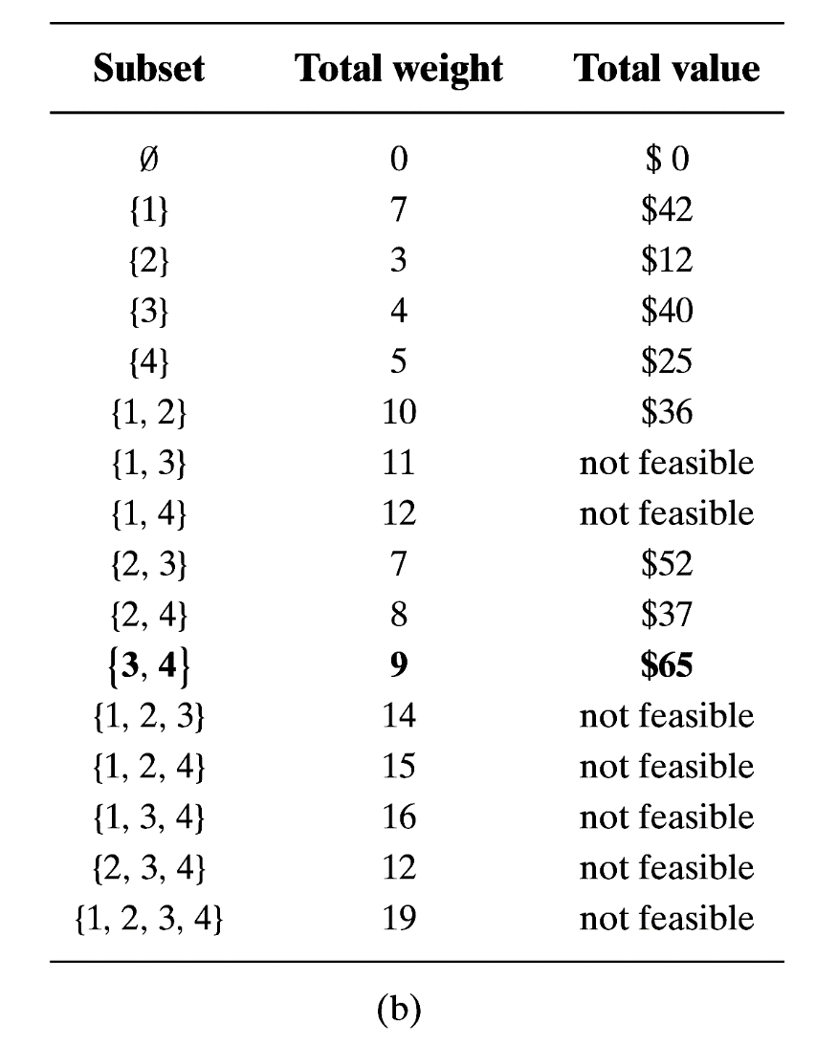
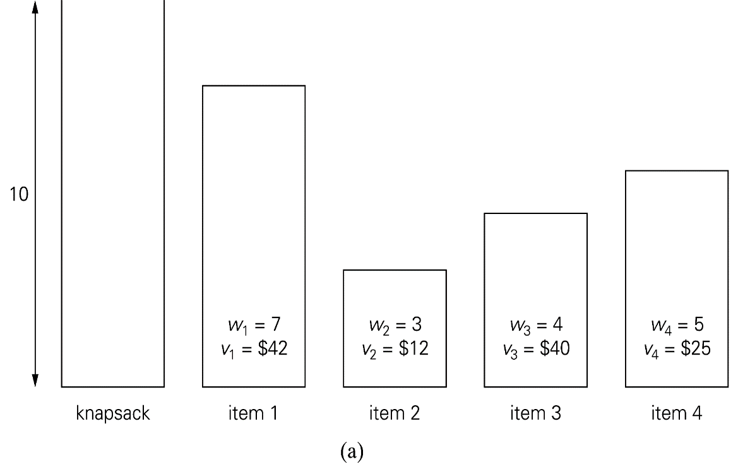
Knapsack Problem
  Example:

Slide 21
Knapsack Problem
Analysis of Exhaustive Search for Knapsack
number of subsets for an n-element set 2^{n}
  For Exhaustive Search for Knapsack Problem and TSP problem,
  examples of so-called NP-hard problem
  no polynomial-time algorithm is known for NP-hard problem

Slide 22
Exhaustive Search: Assignment Problem
Idea
  Problem
There are n people who need to be assigned to n jobs, one person per job.
Each person is assigned to exactly one job, and each job is assigned to exactly one person
The cost of assigning person i to job j is C [i, j]
Find an assignment that minimizes the total cost.

Slide 23
Exhaustive Search: Assignment Problem
  Idea
  describe the feasible solutions to the Assignment Problem as n-tuples <j₁, …, j_{n}> in which the i-th component indicates the column of the element selected in the i-th row (i.e. job number assigned to the i-th person)
  Generating all legitimate assignments,
  Compute their costs
  Select the cheapest one

Slide 24
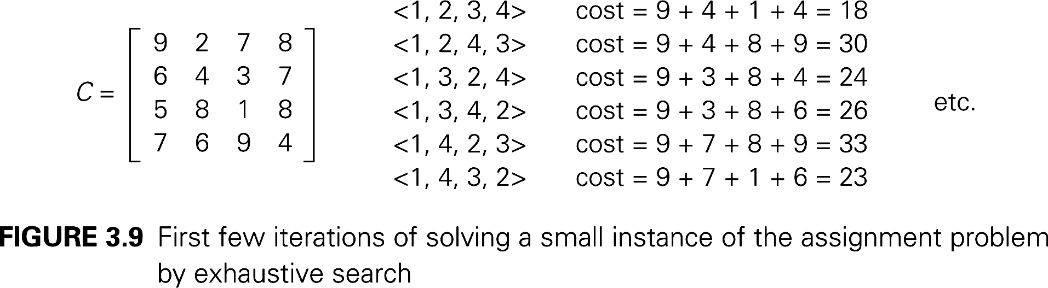
Assignment Problem
  Example:
Job 1 Job 2 Job 3 Job 4
Person 1 9 2 7 8
Person 2 6 4 3 7
Person 3 5 8 1 8
Person 4 7 6 9 4
Pose the problem as the one about a cost matrix:

Slide 25
Assignment Problem
Analysis of Exhaustive Search for Assignment
number of permutations n!
  no known polynomial-time algorithms for problems whose domain grows exponentially with instance size

Slide 26
Summary
蛮力法是一种简单直接地解决问题的方法，通常直接基于问题的描述和所涉及的概念定义
蛮力法的优点：广泛适用性和简单性；蛮力法的缺点：大多效率低
蛮力法一般是得到一个算法，为设计改进算法提供比较依据
穷举法是蛮力法之一，包括旅行商问题，背包问题和分配问题。

